Slide 1
Understanding GPT and GPT-2: Architecture, Training, and Applications
THE FOUNDATIONS
From GPT to GPT-2

Slide 2
BY THE END OF TODAY
Understand unsupervised pretraining
Learn the data and modeling used to train GPT
GPT architecture, scope, and limitations
Train Nano-GPT from scratch
02
03
04

Slide 3
OVERVIEW
Unsupervised Pre-Training
GPT: The Data and Model
NanoGPT Shakespeare Generator
Conclusions, Q&A

Slide 4
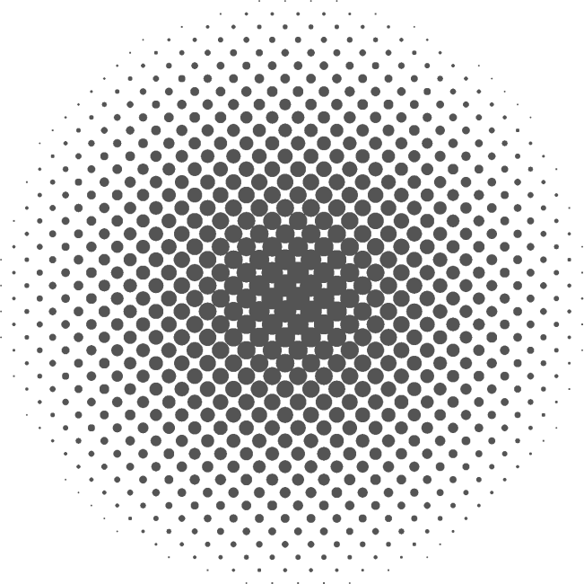

WHY UNSUPERVISED?

Slide 5
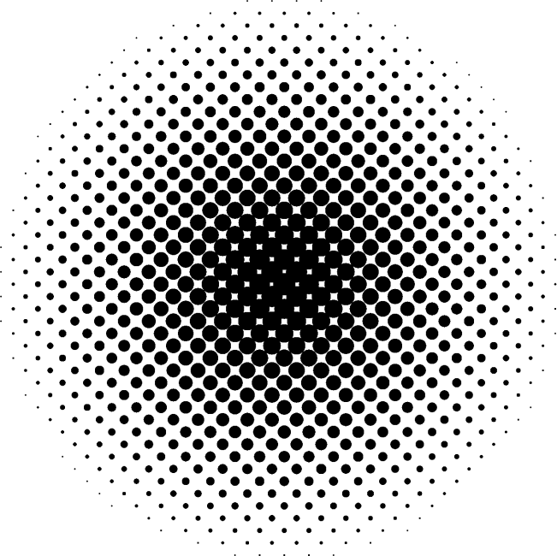
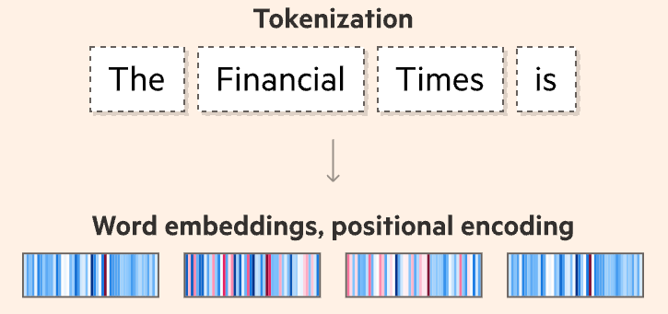

RECALL VOCABULARY
Tokenization
Chop words
Embeddings
Words --> numbers
(Positional) Encoding
Words within sentence

Slide 6
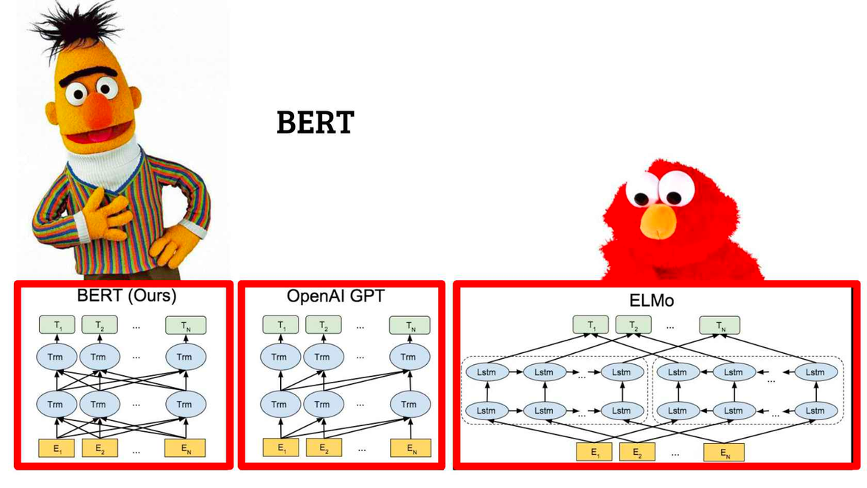
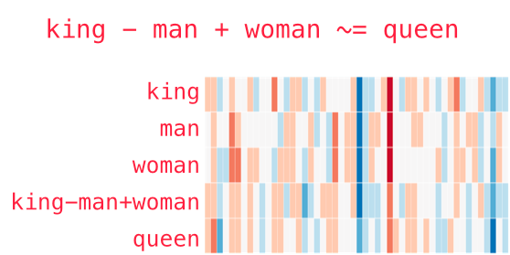
UNSUPERVISED EMBEDDINGS
No-context, word-level
word2vec, GLoVe
Context, sentence-level
ELMo, CoVE

Slide 7
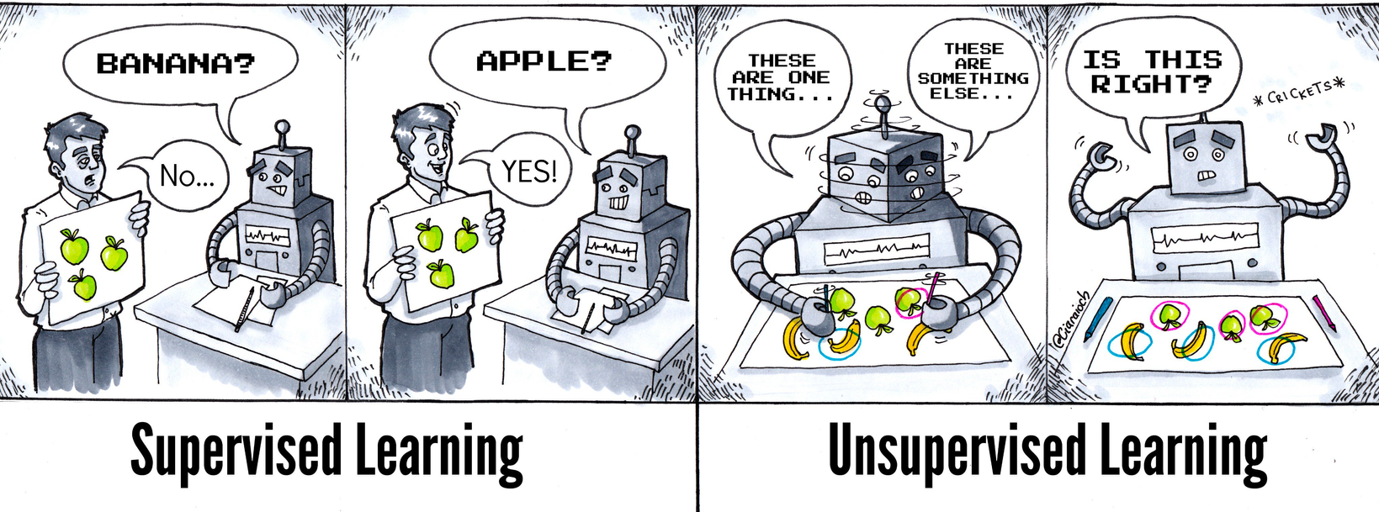
GPT
Generative Pre-trained Transformer
Two ideas
Transformer
Unsupervised Pretraining
Notes:
Early results provided a convincing example that pairing supervised learning methods with unsupervised pretraining works very well.

Slide 8
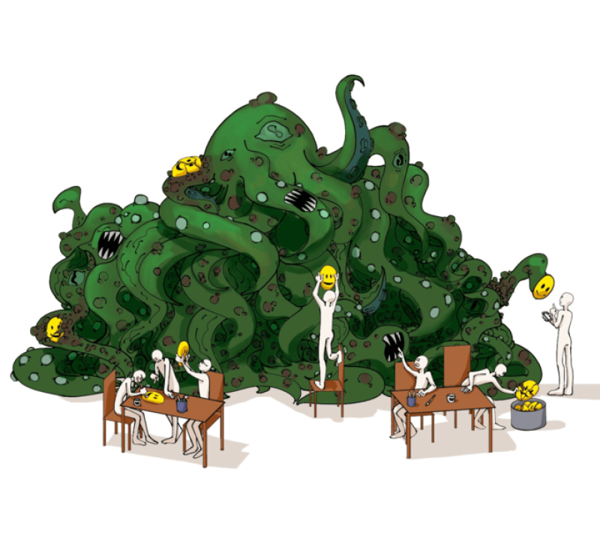
TRAINING PROCESS
Unsupervised Pretraining
Transformer, very large data
Supervised Fine-Tuning
Task-specific, much smaller
Notes:
Early results provided a convincing example that pairing supervised learning methods with unsupervised pretraining works very well.

Slide 9
GPT
Generative Pre-Trained Transformer
Semi-Supervised Sequence Learning (Generate)
ULMFiT (Pre-trained)
Transformer
Notes:
"Builds on the approach introduced in "Semi-Supervised Sequence Learning"
"Extends ULMFiT"

Slide 10
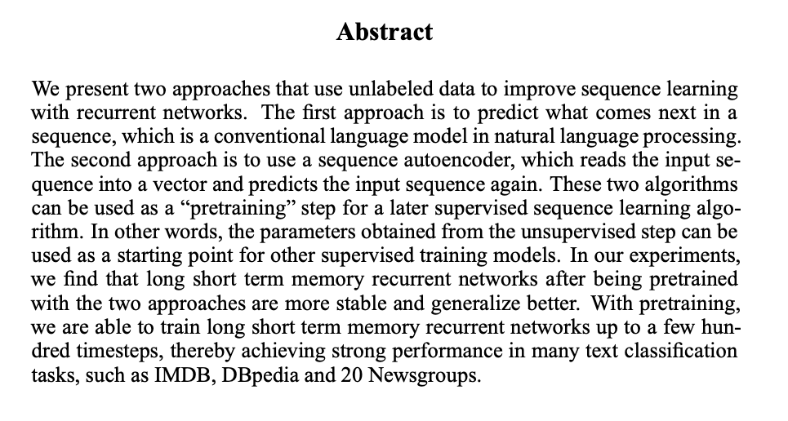
SEMI-SUPERVISED SEQUENCE LEARNING
Notes:
Showed how to improve document classification performance by using unsupervised pre-training of an LSTM followed by supervised fine-tuning.
Two approaches that use unlabeled data to improve sequence learning with RNNs.
Unsupervised Pre-Trianing
- predict what comes next in a
sequence
Supervised Fine-Tuning
- sequence autoencoder, which reads the input sequence into a vector and predicts the input sequence again.
These two algorithms taken together can be used as a “pretraining” step for a later supervised sequence learning algorithm.
In other words, the parameters obtained from the unsupervised step can be
used as a starting point for other supervised training models.
With pretraining, we are able to train long short term memory recurrent networks up to a few hundred timesteps, thereby achieving strong performance in many text classification
tasks, such as IMDB, DBpedia and 20 Newsgroups.

Slide 11
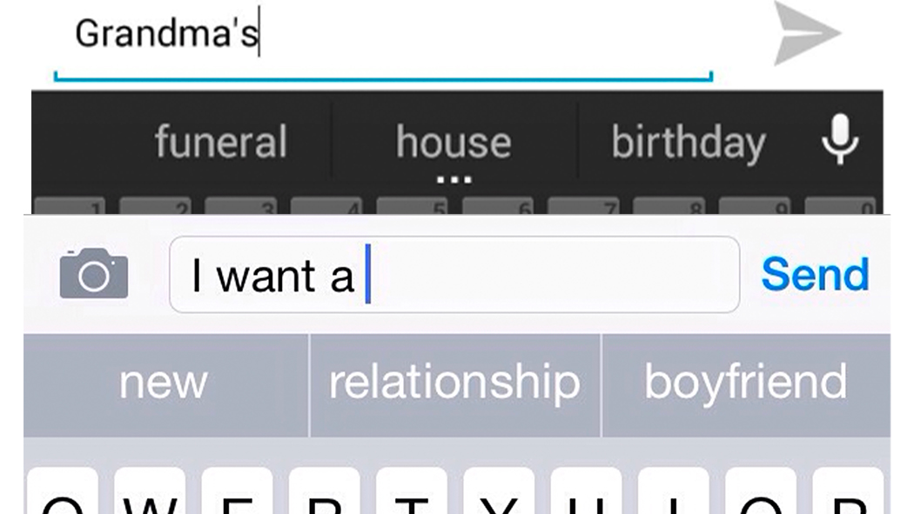
UNSUPERVISED PRETRAINING
“Predict what comes next” wins!

Slide 12
Recall...GPT-style

Slide 13
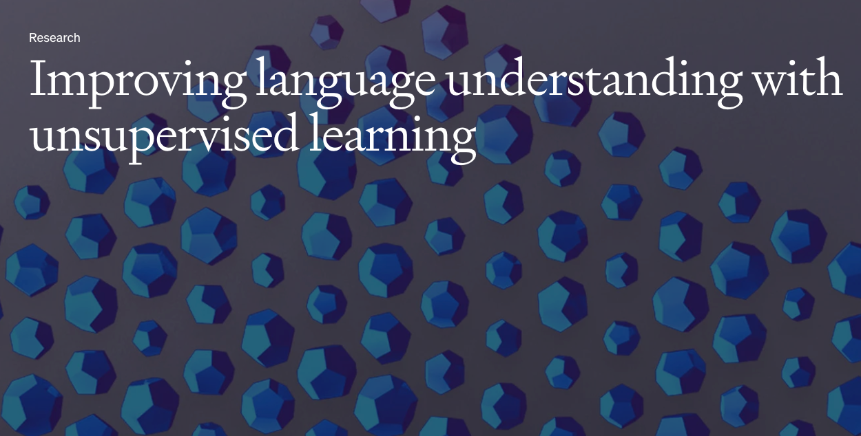
DECODER = GPT
Transformer Type
Auto-regressive
Model-like
GPT-like
Focus
Generative tasks
e.g., chat bot
Notes:
Auto-regressive

Slide 14
Recall...GPT-style

Slide 15
UNIVERSAL LM FT FOR TEXT CLASS
ULMFiT
Transfer learning applied to NLP
A single dataset agnostic LSTM can be fine-tuned for SOTA performance on many different classification tasks
Notes:
GPT also extends ULMFiT, research that shows how a single dataset-agnostic LSTM language model can be fine-tuned to get state-of-the-art performance on a variety of document classification datasets
Inductive transfer learning has greatly impacted computer vision, but existing approaches in NLP still require task-specific
modifications and training from scratch.
We propose Universal Language Model Fine-tuning (ULMFiT), an effective transfer learning method that can be applied to any task in NLP, and introduce techniques that are key for fine-tuning a language
model.
Our method significantly outperforms the state-of-the-art on six text classification tasks, reducing the error by 18-24% on the majority of datasets. Furthermore, with only 100 labeled examples, it
matches the performance of training from scratch on 100× more data. We opensource our pretrained models and code1
.

Slide 16
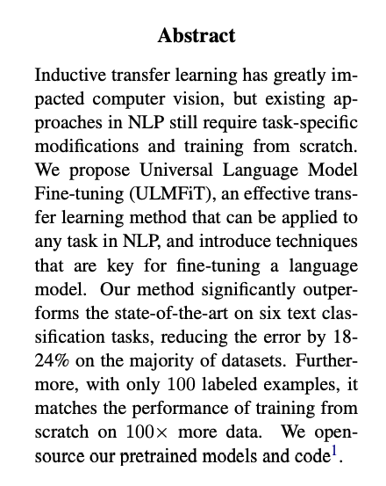
ULMFiT
Notes:
GPT also extends ULMFiT, research that shows how a single dataset-agnostic LSTM language model can be fine-tuned to get state-of-the-art performance on a variety of document classification datasets
Inductive transfer learning has greatly impacted computer vision, but existing approaches in NLP still require task-specific
modifications and training from scratch.
We propose Universal Language Model Fine-tuning (ULMFiT), an effective transfer learning method that can be applied to any task in NLP, and introduce techniques that are key for fine-tuning a language
model.
Our method significantly outperforms the state-of-the-art on six text classification tasks, reducing the error by 18-24% on the majority of datasets. Furthermore, with only 100 labeled examples, it
matches the performance of training from scratch on 100× more data. We opensource our pretrained models and code1
.

Slide 17
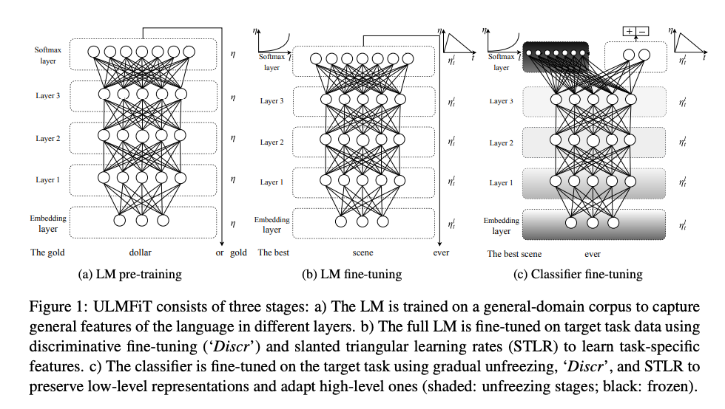
ULMFiT
Notes:
GPT also extends ULMFiT, research that shows how a single dataset-agnostic LSTM language model can be fine-tuned to get state-of-the-art performance on a variety of document classification datasets
Inductive transfer learning has greatly impacted computer vision, but existing approaches in NLP still require task-specific
modifications and training from scratch.
We propose Universal Language Model Fine-tuning (ULMFiT), an effective transfer learning method that can be applied to any task in NLP, and introduce techniques that are key for fine-tuning a language
model.
Our method significantly outperforms the state-of-the-art on six text classification tasks, reducing the error by 18-24% on the majority of datasets. Furthermore, with only 100 labeled examples, it
matches the performance of training from scratch on 100× more data. We opensource our pretrained models and code1
.

Slide 18
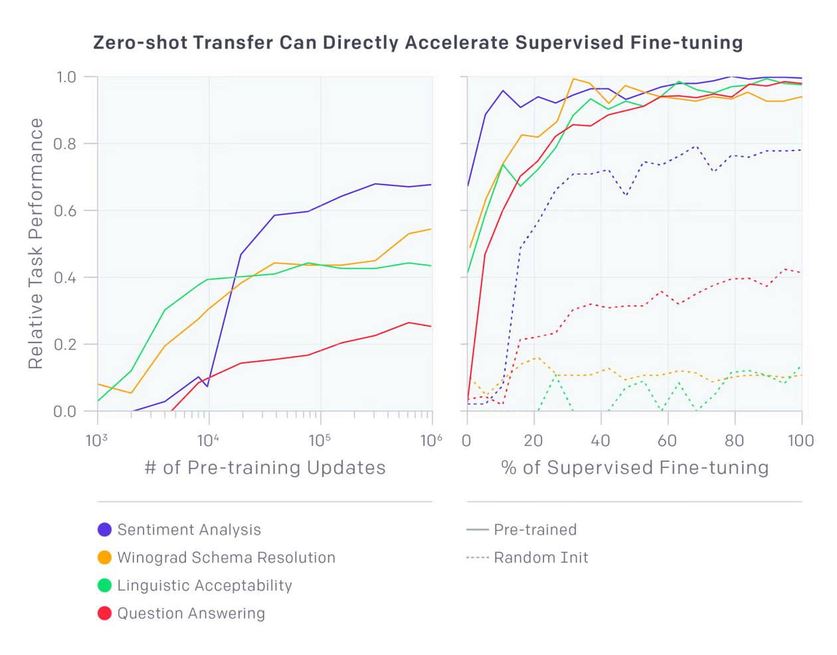
GPT
Task-specific performance steadily increases as the underlying model improves

Slide 19
GPT
Generative Pre-Trained Transformer
Semi-Supervised Sequence Learning (Generative)
ULMFiT (Pre-trained)
Transformer
Notes:
"Builds on the approach introduced in "Semi-Supervised Sequence Learning"
"Extends ULMFiT"

Slide 20
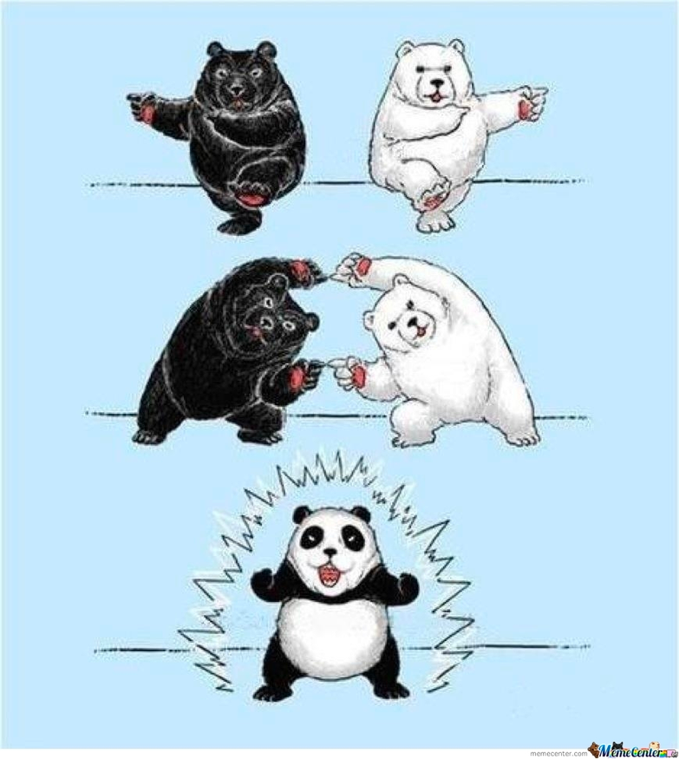
GPT
Generative Pre-Trained Transformer
Combines two ideas:
Unsupervised pretraining
Transformer

Slide 21
We’ve obtained state-of-the-art results on a suite of diverse language tasks with a scalable, task-agnostic system.
These results provide a convincing example that pairing supervised learning methods with unsupervised pretraining works very well.

Slide 22
“Very little tuning was used to achieve our results.”
Notes:
All datasets use a single forward language model, without any ensembling, and the majority of the reported results use the exact same hyperparameter settings.

Slide 23
Our results are a promising step towards general unsupervised representation learning. We found the results by exploring whether we could learn good quality representations as a side effect of language modeling, and scaled up an existing model on a carefully-chosen dataset. Yet the underlying phenomena remain more mysterious than clear.

Slide 24
GPT
Task-specific performance steadily increases as the underlying model improves
Notes:
While the absolute performance of these methods is still often quite low compared to the supervised state-of-the-art (for question answering it still outperformed by a simple sliding-window baseline) it is encouraging that this behavior is robust across a broad set of tasks. Randomly initialized networks containing no information about the task and the world perform no-better than random using these heuristics. This provides some insight into why generative pre-training can improve performance on downstream tasks.

Slide 25
TRAINING DETAILS
Model
37-layer (12 block) Transformer
Train on 512 token sequence
Data
BooksCorpus dataset
Training
One month on 8 P600 GPUs (0.96 petaflop days)
Notes:
It contains over 7,000 unique unpublished books from a variety of genres including Adventure,
Fantasy, and Romance. Crucially, it contains long stretches of contiguous text, which allows the
generative model to learn to condition on long-range information.

Slide 26
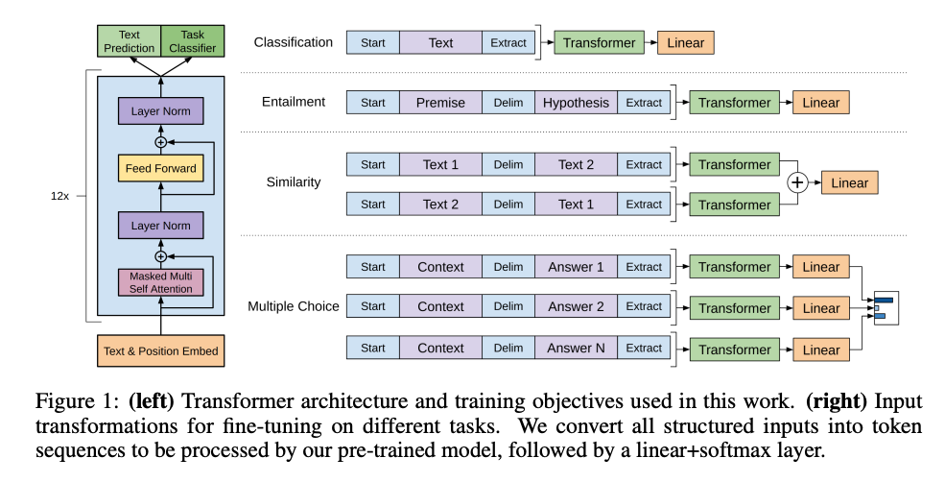
TRAINING DETAILS
Notes:
For some tasks, like text classification, we can directly fine-tune our model as described above.
Certain other tasks, like question answering or textual entailment, have structured inputs such as
ordered sentence pairs, or triplets of document, question, and answers. Since our pre-trained model
was trained on contiguous sequences of text, we require some modifications to apply it to these tasks.

Slide 27
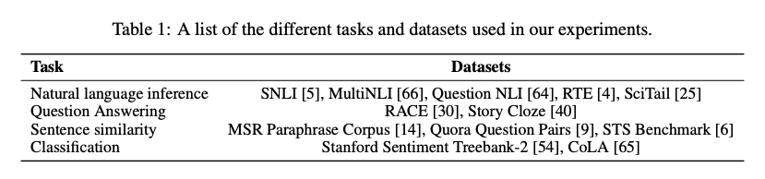
GPT
Task-specific performance steadily increases as the underlying model improves

Slide 28

LIMITATIONS & DRAWBACKS
Compute Requirements
Limits of bias and learning about the world through text
Still brittle generalization
Prompt: limitations of Generative AI models
Notes:
Compute Requirements: Many previous approaches to NLP tasks train relatively small models on a single GPU from scratch. Our approach requires an expensive pre-training step—1 month on 8 GPUs. Luckily, this only has to be done once and we’re releasing our model so others can avoid it. It is also a large model (in comparison to prior work) and consequently uses more compute and memory—we used a 37-layer (12 block) Transformer architecture, and we train on sequences of up to 512 tokens. Most experiments were conducted on 4 and 8 GPU systems. The model does fine-tune to new tasks very quickly which helps mitigate the additional resource requirements.
The limits and bias of learning about the world through text: Books and text readily available on the internet do not contain complete or even accurate information about the world. Recent work has shown that certain kinds of information are difficult to learn via just text and other work has shown that models learn and exploit biases in data distributions.
Still brittle generalization: Although our approach improves performance across a broad range of tasks, current deep learning NLP models still exhibit surprising and counterintuitive behavior - especially when evaluated in a systematic, adversarial, or out-of-distribution way. Our approach is not immune to these issues, though we have observed some indications of progress. Our approach shows improved lexical robustness over previous purely neural approaches to textual entailment. On the dataset introduced in Glockner et al. (2018) our model achieves 83.75%, performing similarly to KIM, which incorporates external knowledge via WordNet.

Slide 29
FUTURE WORK (--> GPT-2)
Scaling the approach
Improved fine-tuning
Better understanding of why generative pre-training helps.
Notes:
Scaling the approach: We’ve observed that improvements in the performance of the language model are well correlated with improvements on downstream tasks. We’re currently using commodity hardware (a single 8 GPU machine) and a training dataset of only a few thousand books (~5GB of text). This suggests there is significant room for improvement using the well-validated approach of more compute and data.
Improved fine-tuning: Our approach is currently very simple. It is likely that substantial improvements can be made using more intricate adaptation and transfer techniques such as those explored in ULMFiT.
Better understanding of why generative pre-training helps: Although we’ve discussed some ideas we are partial to here, more targeted experiments and research will help distinguish between competing explanations. For instance, how much of the benefits we observe are due to improved ability to process broader context versus improved world knowledge?

Slide 30
A hypothesis is that the underlying generative model learns to perform many of the tasks we evaluate on in order to improve its language modeling capability and that the more structured attentional memory of the transformer assists in transfer compared to LSTMs.

Slide 31
